Slide 1

Heart Attack Prediction
Using Naive Bayes Classifier

Slide 2

Agenda
01
Data Set Features
02
Outliers & Handling Them
03
Descriptive Statistics
04
Data Standardization & Partitioning
05
Visualizations
06
Naive Bayes Classifier
07
Analysis Results

Slide 3

Dataset Quantitative Features
age
Age of Patient
01
02
Resting Blood Pressure
trtbps
chol
Cholesterol Level
03
04
Maximum Heart Rate
thalachh
oldpeak
ST Depression Induced By Exercise Relative To rest
05
06
Number of Major Blood Vessels Colored By Fluoroscopy
caa

Slide 4
Dataset Categorical Features
sex
Gender of Patient
01
02
Type of Chest Pain
cp
fbs
Fasting Blood Sugar Level
03
04
Results of Resting ECG
restecg
exng
Experienced Angina Induced By Exercise
05
06
Slope of ST Segment During Exercise
slp
thall
Type of Thalassemia
07
08
Heart Attack Occurred or Not
output

Slide 5
What are outliers?
Data points that deviate significantly from the majority of the observations in a dataset.
High or low values that are distant from the central tendency of the data.
Result in measurement errors or data entry mistakes affecting overall data quality.
Affect statistical measures [mean, standard deviation, correlation coefficients] causing misleading analysis results.
Algorithms like linear regression are sensitive to outliers, and their presence can lead to biased parameter estimates and poor model performance.
Why handling them?

Slide 6
Detecting Outliers & Handling Them
Visual Inspection of data plots (box plots, scatter plots)
Statistical techniques (z-scores, modified z-scores)
Machine learning algorithms (clustering, isolation forests).
Then we used IQR Method to remove them.

Slide 7
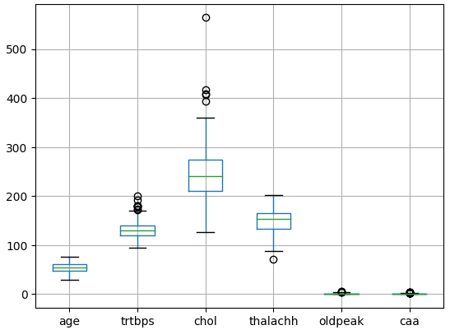
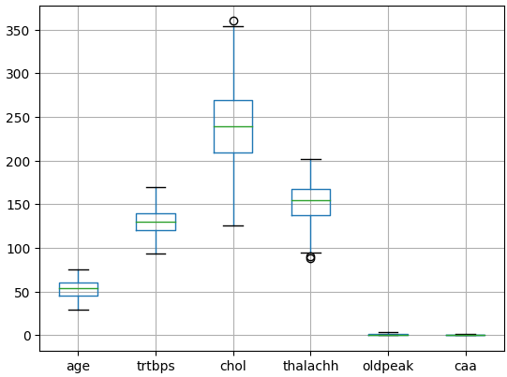
Detecting Outliers & Handling Them

Slide 8
A
Quantitative
Measures of Dispersion
[ Range, Variance, SD, IQR ]
Measures of Central Tendency
[ Mean, Median, Mode]
Descriptive Statistics
B
Categorical
Frequency Counts
Visualizations
[Pie Charts. Bar Charts]

Slide 9
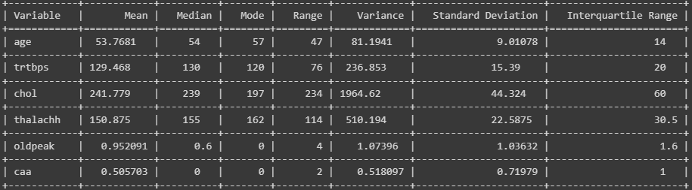
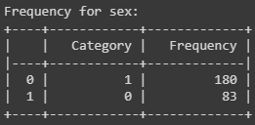
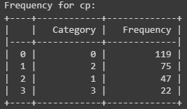
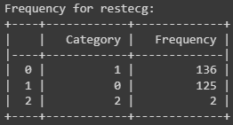
Descriptive Statistics

Slide 10
Data Standardization
Z-Score = (x-μ) / σ
A process of transforming data to have a common scale or distribution.
Ensures standardized data have Mean = 0
Ensures standardized data have Standard Deviation = 1

Slide 11
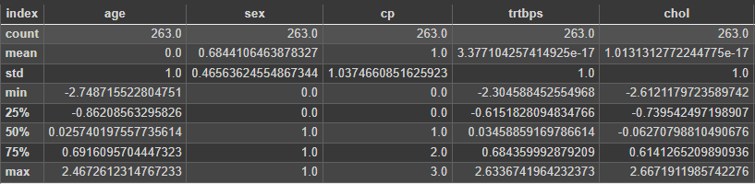
Data Standardization
Z-Score = (x-μ) / σ

Slide 12
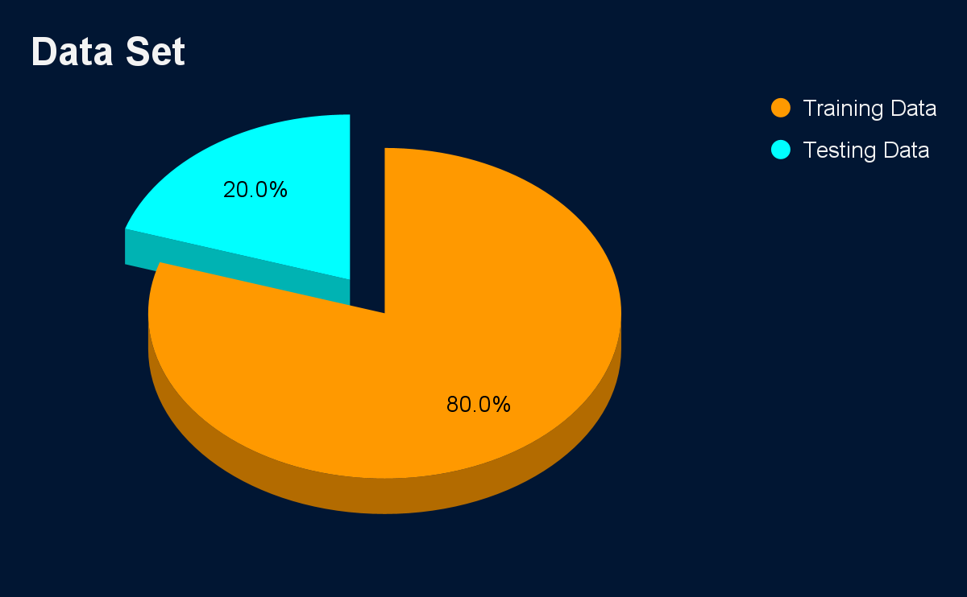
Data Partitioning
Model Training
A
Model Evaluation
B
Assessing Performance
C
Detecting Overfitting
D

Slide 13
Visualizing & Testing Our Quantitative Features

Slide 14
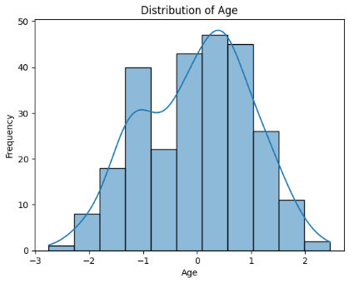
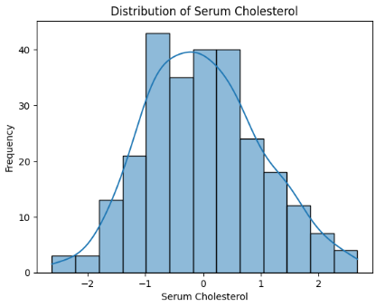
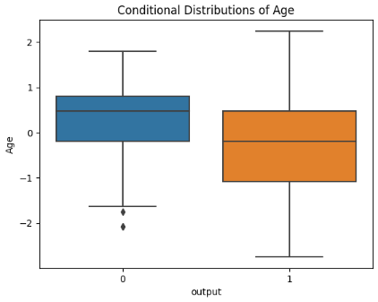
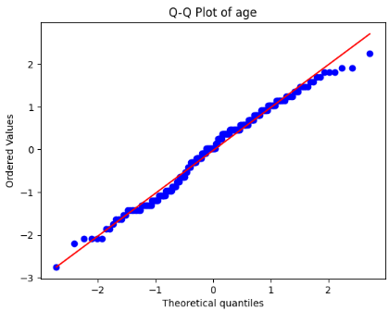
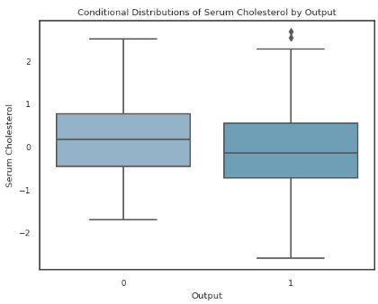
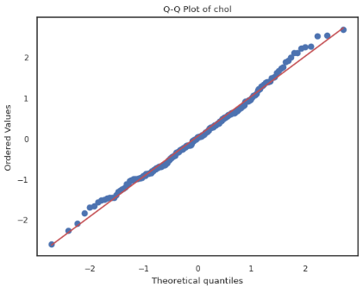
age
trtbps

Slide 15

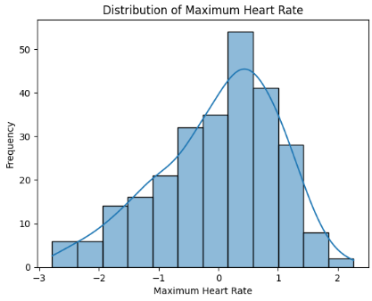
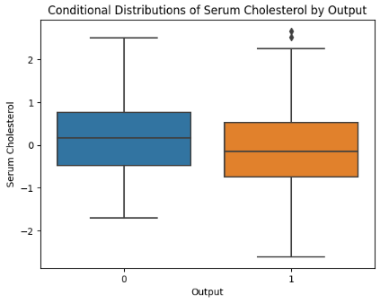
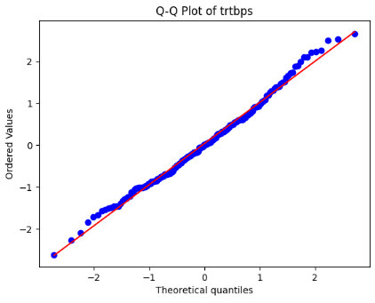
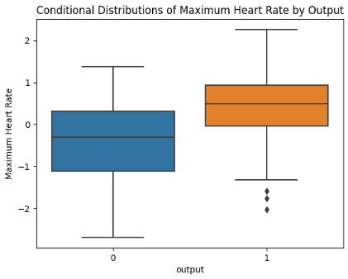
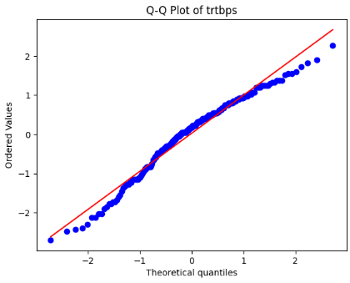
chol
thalachh

Slide 16
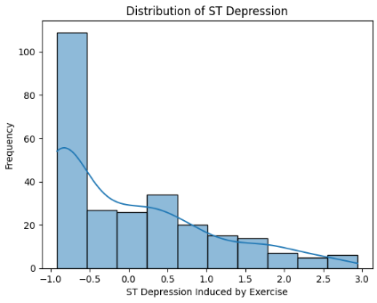
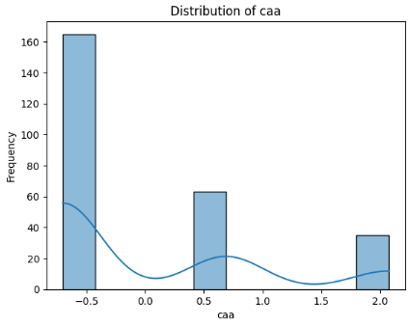
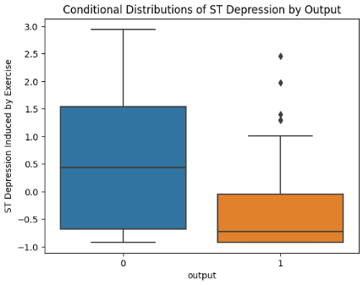
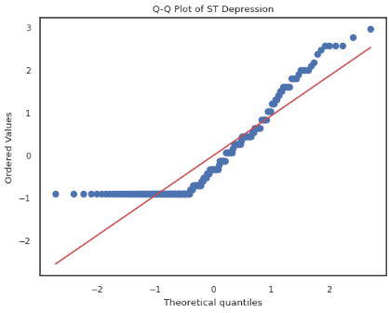
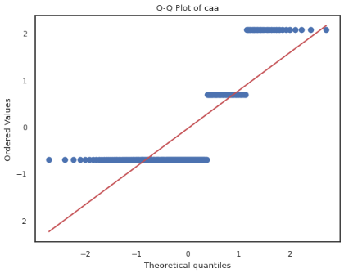
oldpeak
caa

Slide 17
Visualizing & Testing Our Categorical Features

Slide 18
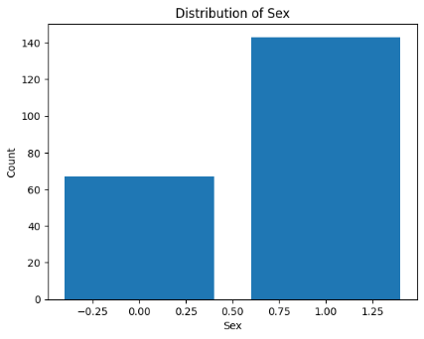
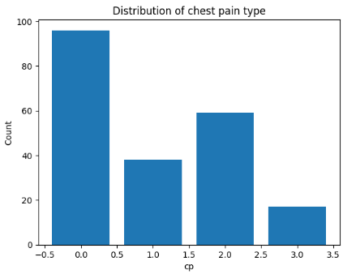
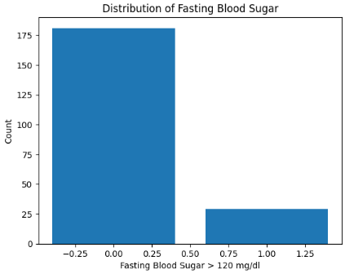
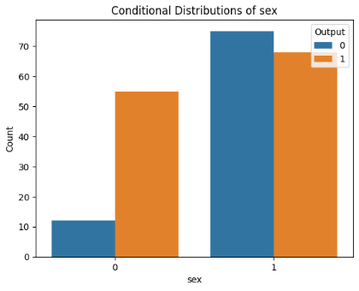
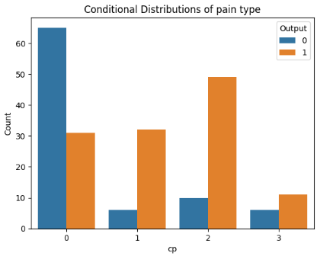

sex
cp
fbs

Slide 19
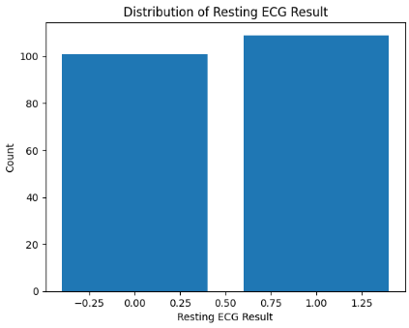
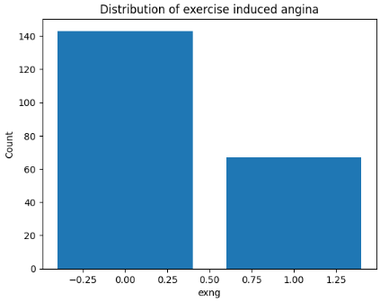
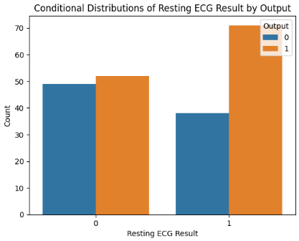
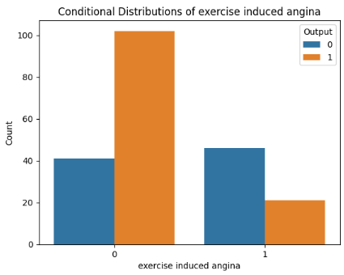
restecg
exng

Slide 20
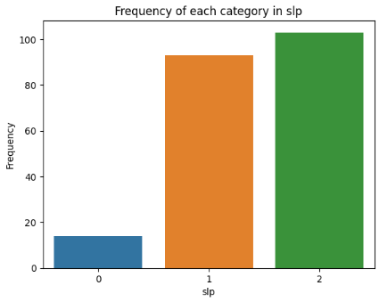
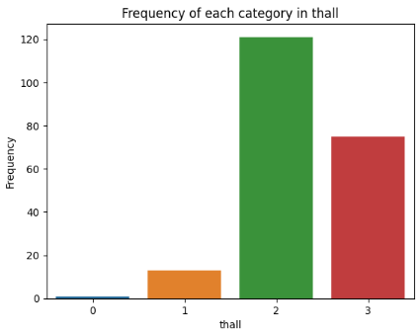
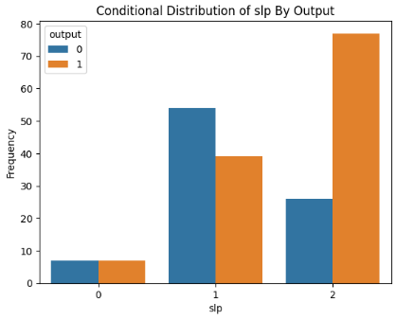
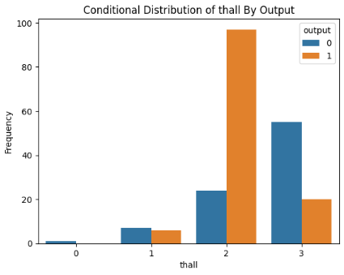
slp
thall

Slide 21
Implementing Naive Bayes Classifier
(From 0 to Hero)

Slide 22
What is Naive Bayes Classifier?
The Naive Bayes Classifier is based on Bayes' theorem, which is a fundamental concept in probability theory.
P(Y | X1, X2, ..., Xn) = (P(X1, X2, ..., Xn | Y) * P(Y)) / P(X1, X2, ..., Xn)
It makes use of conditional probability to classify data into different categories or classes.
The "naive" assumption in Naive Bayes is that all features are conditionally independent given the class.
The purpose of the Naive Bayes classifier is to classify new data instances based on their feature values.
It calculates the posterior probability for each class and assigns the data instance to the class with the highest probability.
The classifier predicts the class label that maximizes the posterior probability.

Slide 23
Model Training & Prediction
Training
Testing
Check dependencies among features
Replotting numerical features’ distribution to check fitting known distribution
Calculate prior probabilities of each class
Calculate probabilities of given feature given specific class
Use trained classifier to predict target labels for the testing data
Evaluate the accuracy by comparing predicted labels with true labels
Compute classifier performance using confusion matrix & f1 score

Slide 24
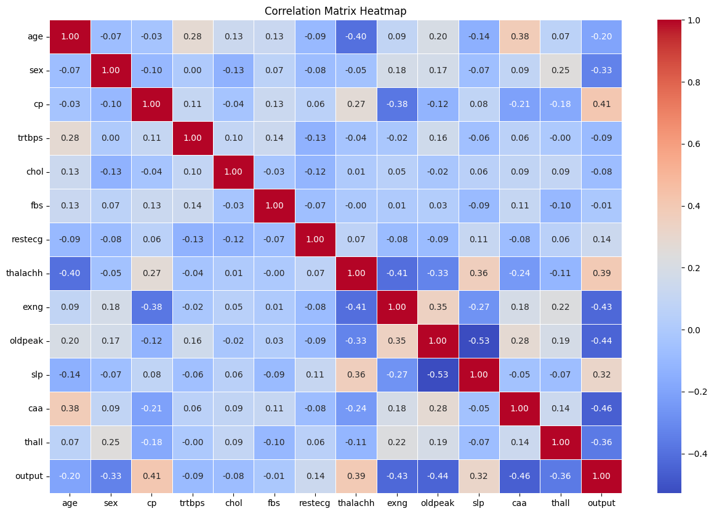

Slide 25
Evaluation Comparison
88.679%
Mixed Naive Bayes Classifier
86.206%
Our Implemented Naive Bayes Classifier

Slide 26
Analysis Results
01
03
Outlier Detection
Naive Bayes Classifier
Exploratory Data Analysis
Data Standardization
Variables became more representative of the underlying population.
More robust analysis
Confusion matrix =
[[20 4] [4 25]]
Our Implementation Accuracy = 86.206%
Standard Naive Bayes Classifier Accuracy = 88.679%
Transformed the features to a common scale, enabling fair comparison
Eliminating potential bias
Accurate calculation of probabilities in the Naive Bayes classifier
Some variables exhibited Gaussian distributions ( age, trtbps, chol, thalachh )
Others had skewed("oldpeak“, “caa”)
02
04

Slide 27
Our Team
Luna Eyad
Rana Hany
Malak Nasser
Sara Mohamed
Raghda Tarek Neiazy

